Slide 1

Testing Swapped and Short Wires in Cables

Slide 2
Problem:
Swapped wires in cables
Short between Wires in connector.
Control printing labels for only the passed items.

Slide 3
Objectives:
Test the swapped and short wires in different cables items ,automate and control labels printing for passed items with desktop application.

Slide 4
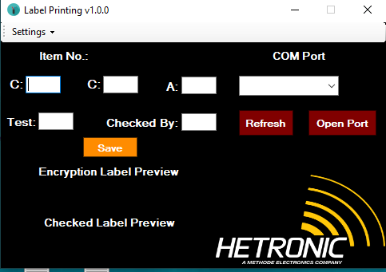
Desktop Application:

Slide 5
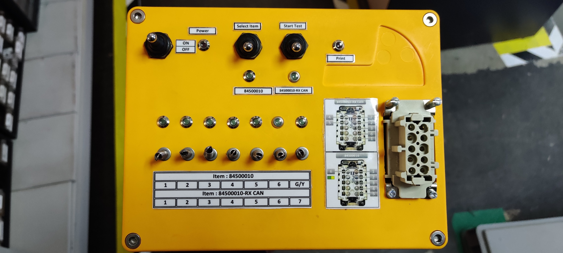
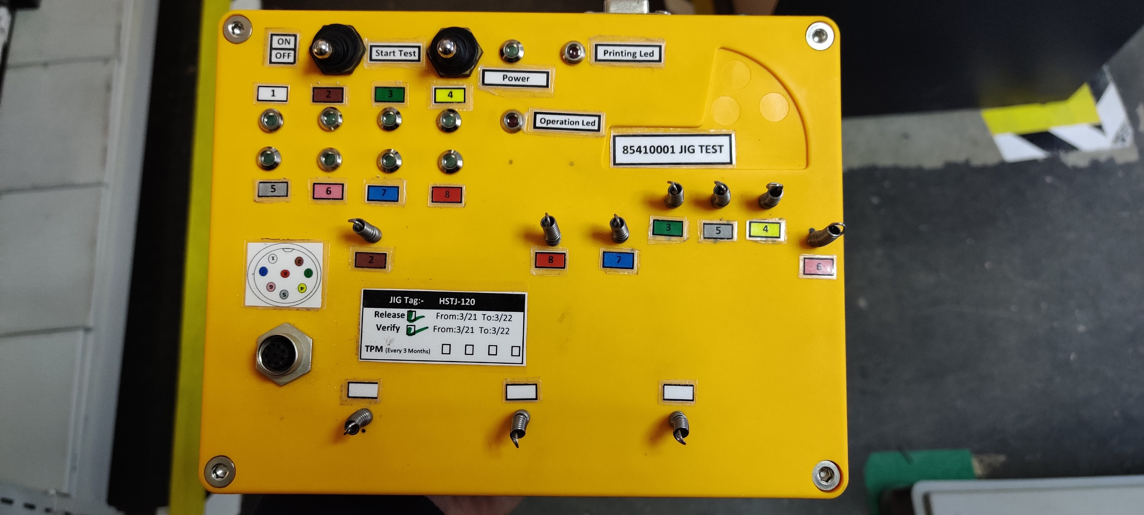
Semi-Automation Projects
84500010 / 84500010-RXCAN Test JIG | 85410001 Test JIG
Benefits:
Test jig been built using micro controller to detect Swapped, Shorted, Open Wiring Connections
Test Jig will provide the test result whether the harness Passed or Fail
Prior release of these jigs, wires are being tested one by one, as a result:
Inspection Time been reduced
Risk of having wires not tested or escape been avoided

Slide 6
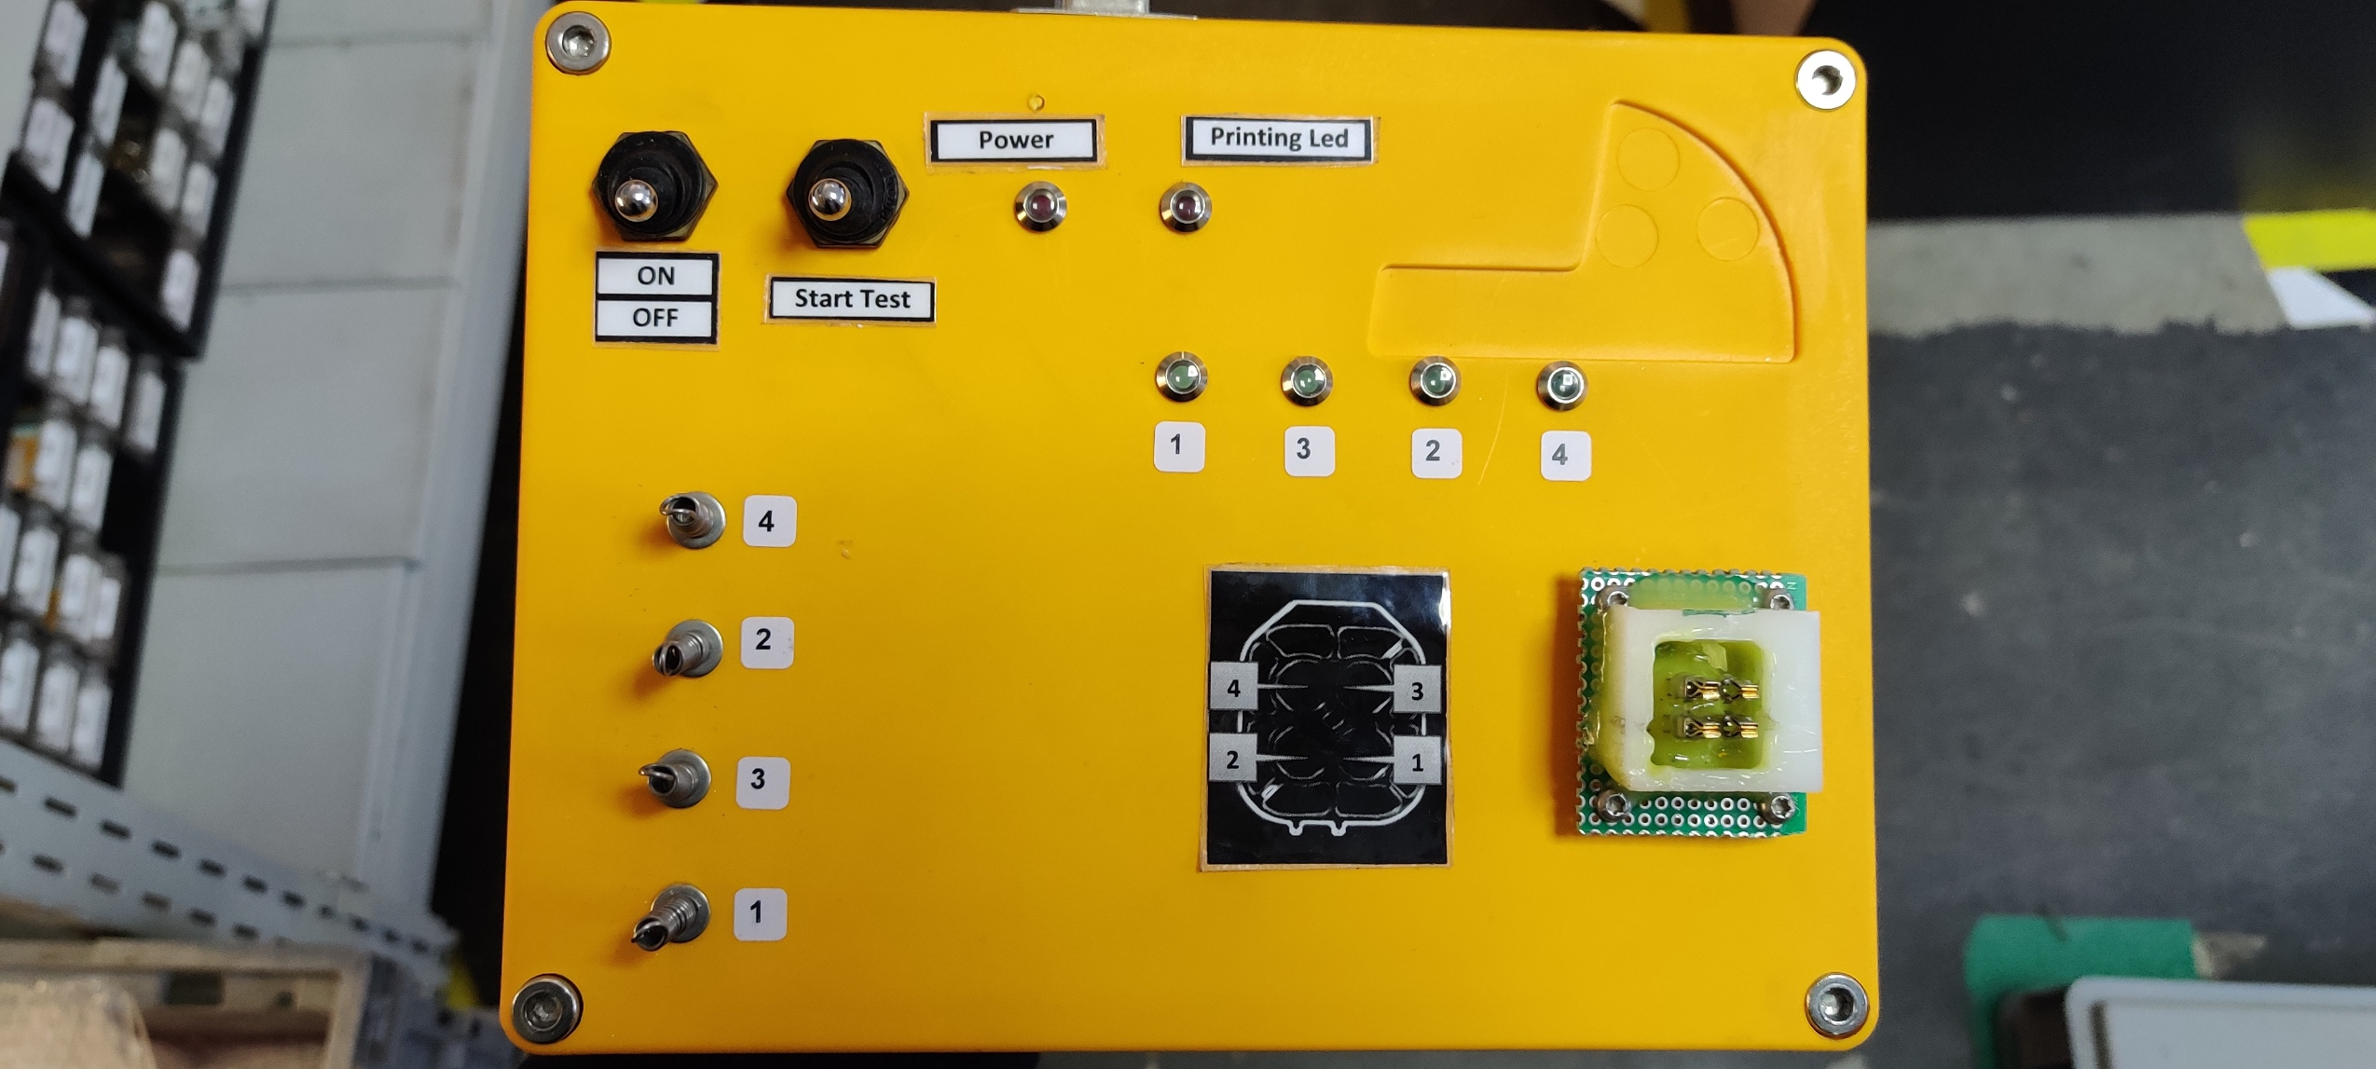
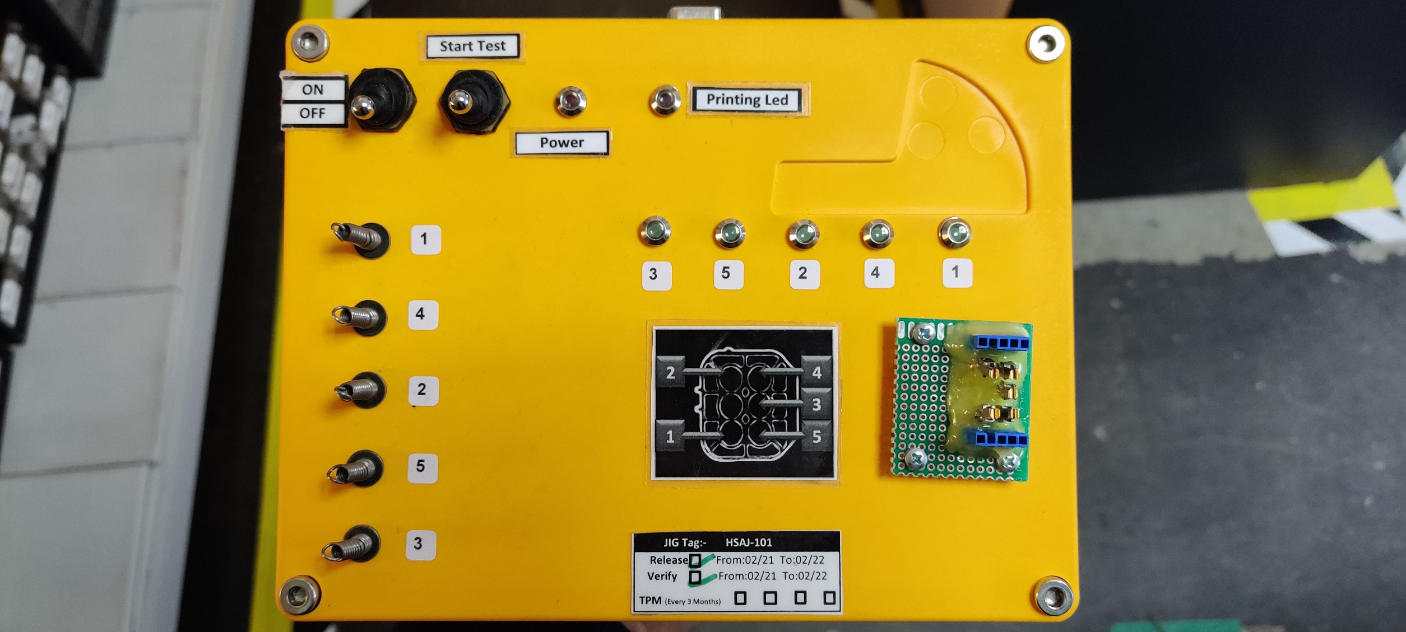
Semi-Automation Projects
09000010-UNIC Test JIG | 09000020-UNIC Test JIG
Benefits:
Test jig been built using micro controller to detect Swapped, Shorted, Open Wiring Connections
Test Jig will provide the test result whether the harness Passed or Fail
Prior release of these jigs, wires are being tested one by one, as a result:
Inspection Time been reduced
Risk of having wires not tested or escape been avoided

Slide 7
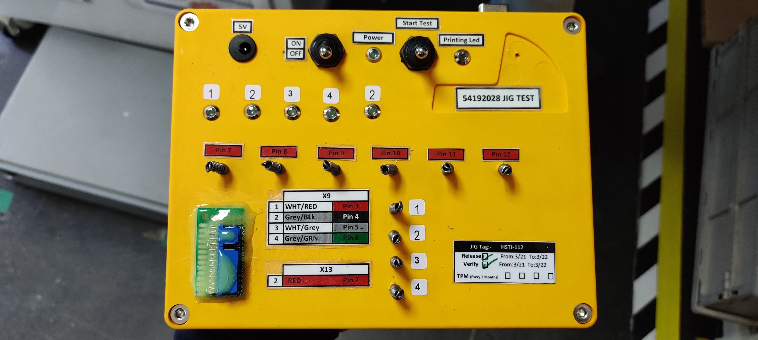
Semi-Automation Projects
54192028 Test JIG
Benefits:
Test jig been built using micro controller to detect Swapped, Shorted, Open Wiring Connections
Test Jig will provide the test result whether the harness Passed or Fail
Prior release of these jigs, wires are being tested one by one, as a result:
Inspection Time been reduced
Risk of having wires not tested or escape been avoided

Slide 8
Thank You

